Slide 1
Computer vision: models, learning and inference
Chapter 10
Graphical Models

Slide 2
Independence
Two variables x₁ and x₂ are independent if their joint probability distribution factorizes as
Pr(x₁, x₂)=Pr(x₁) Pr(x₂)

Slide 3
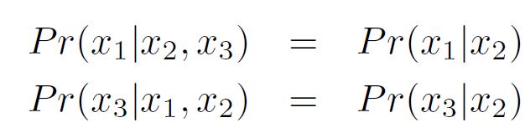
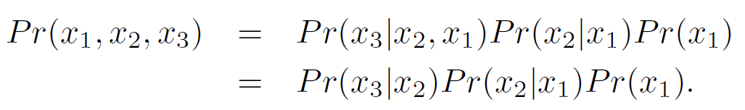




Conditional independence
The variable x₁ is said to be conditionally independent of x₃ given x₂ when x₁ and x₃ are independent for fixed x₂.
When this is true the joint density factorizes in a certain way and is hence redundant.

Slide 4

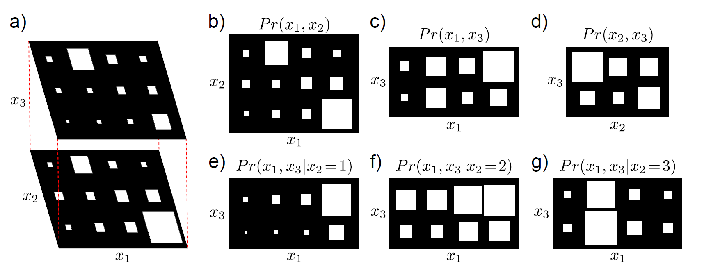
Conditional independence
Consider joint pdf of three discrete variables x₁, x₂, x₃

Slide 5
Conditional independence
Consider joint pdf of three discrete variables x₁, x₂, x₃
The three marginal distributions show that no pair of variables is independent

Slide 6
Conditional independence
Consider joint pdf of three discrete variables x₁, x₂, x₃
The three marginal distributions show that no pair of variables is independent
But x₁ is independent of x₃ given x₂

Slide 7
Graphical models
A graphical model is a graph based representation that makes both factorization and conditional independence relations easy to establish
Two important types:
Directed graphical model or Bayesian network
Undirected graphical model or Markov network

Slide 8
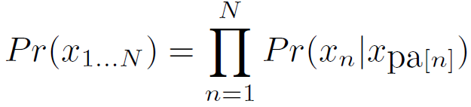




Directed graphical models
Directed graphical model represents probability distribution that factorizes as a product of conditional probability distributions
where pa[n] denotes the parents of node n

Slide 9




Directed graphical models
To visualize graphical model from factorization
add one node per random variable and draw arrow to each variable from each of its parents.
To extract factorization from graphical model
Add one term per node in the graph Pr(x_{n}| x_{pa[n]})
If no parents then just add Pr(x_{n})

Slide 10
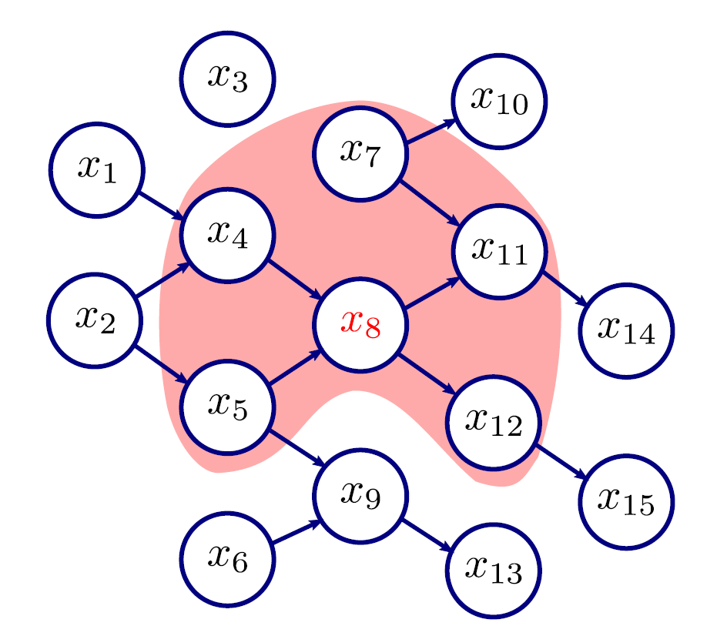
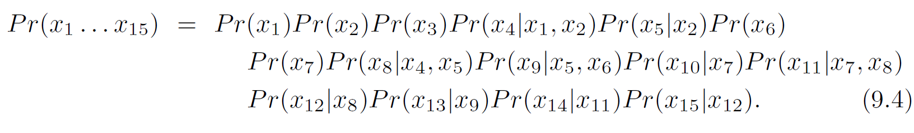
Example 1

Slide 11

Example 1
If there is no route between two variables and they share no ancestors, they are independent.

Slide 12

Example 1
A variable is conditionally independent of all others, given its Markov Blanket

Slide 13
Example 1
= Markov Blanket of variable x₈ – Parents, children and parents of children: all we need to predict x₈
Notes:
even if we fix x11, x8 still depends on what happens at x7: x8 is not conditionally independent of x7 given x11.

Slide 14
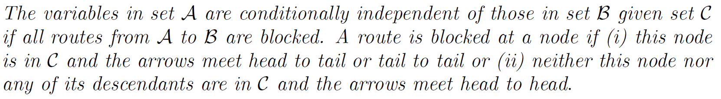




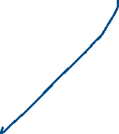



Example 1
General rule:

Slide 15
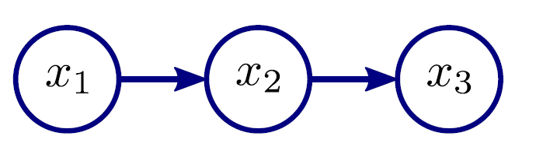
Example 2
The joint pdf of this graphical model factorizes as:

Slide 16

Example 2
The joint pdf of this graphical model factorizes as:
It describes the original example:

Slide 17

Example 2
Here the arrows meet head to tail at x₂, and so x₁ is conditionally independent of x₃ given x₂.
General rule:

Slide 18
Redundancy
Conditional independence can be thought of as redundancy in the full distribution
+ 3 x 4 + 2 x 3
= 22 entries
4 x 3 x 2 = 24 entries
Redundancy here only very small, but with larger models can be very significant.

Slide 19
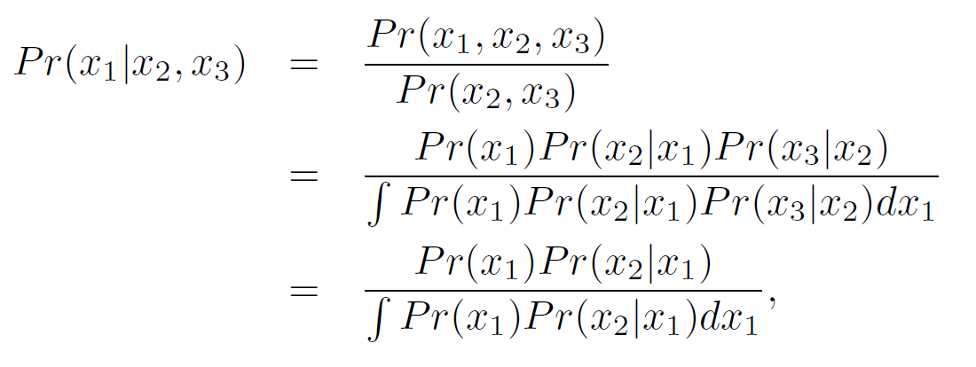
Example 2
Algebraic proof:
No dependence on x₃ implies that x₁ is conditionally independent of x₃ given x₂.

Slide 20
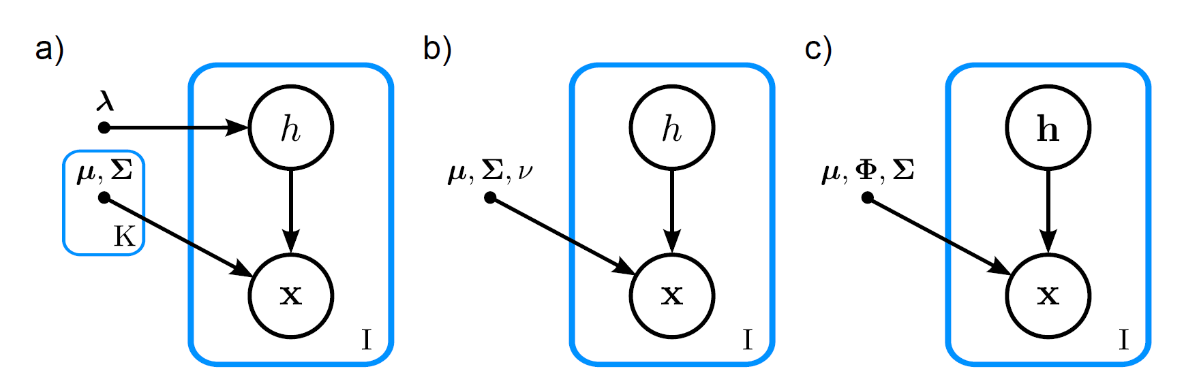
Example 3
Mixture of Gaussians
t-distribution
Factor analyzer
Blue boxes = Plates. Interpretation: repeat contents of box number of times in bottom right corner.
Bullet = variables which are not treated as uncertain

Slide 21
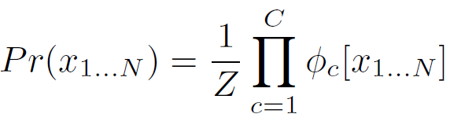


Undirected graphical models
Probability distribution factorizes as:
Partition function (normalization constant)
Product over C functions
Potential function
(returns non-negative number)

Slide 22
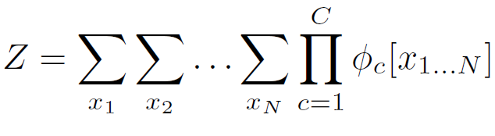
Undirected graphical models
Probability distribution factorizes as:
Partition function (normalization constant)
For large systems, intractable to compute

Slide 23
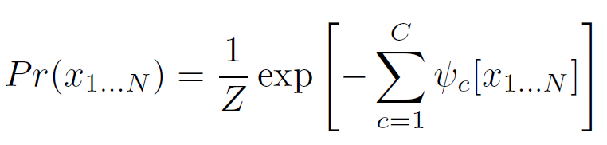

Alternative form
Can be written as Gibbs Distribution:
where
Cost function
(positive or negative)

Slide 24
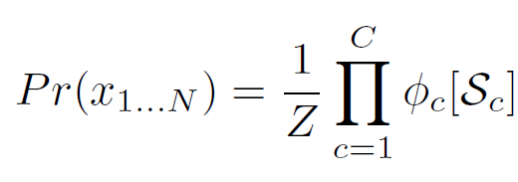







Cliques
Better to write undirected model as
Product over cliques
Clique
Subset of variables

Slide 25



Undirected graphical models
To visualize graphical model from factorization
Sketch one node per random variable
For every clique, sketch connection from every node to every other
To extract factorization from graphical model
Add one term to factorization per maximal clique (fully connected subset of nodes where it is not possible to add another node and remain fully connected)

Slide 26

Conditional independence
Much simpler than for directed models:
One set of nodes is conditionally independent of another given a third if the third set separates them (i.e. Blocks any path from the first node to the second)

Slide 27
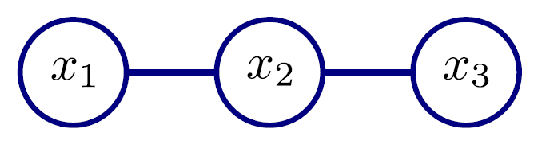
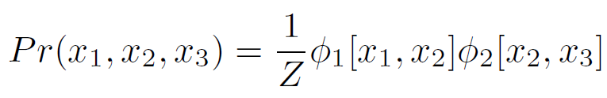
Example 1
Represents factorization:

Slide 28
Example 1
By inspection of graphical model:
x₁ is conditionally independent of x₃ given x₂, as the route from x₁ to x₃ is blocked by x₂.

Slide 29
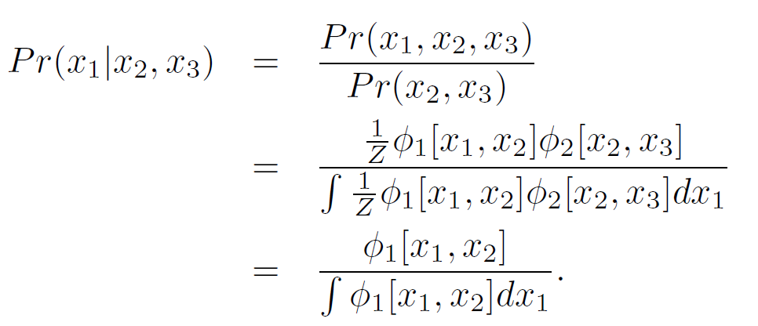
Example 1
Algebraically:
No dependence on x₃ implies that x₁ is conditionally independent of x₃ given x₂.

Slide 30
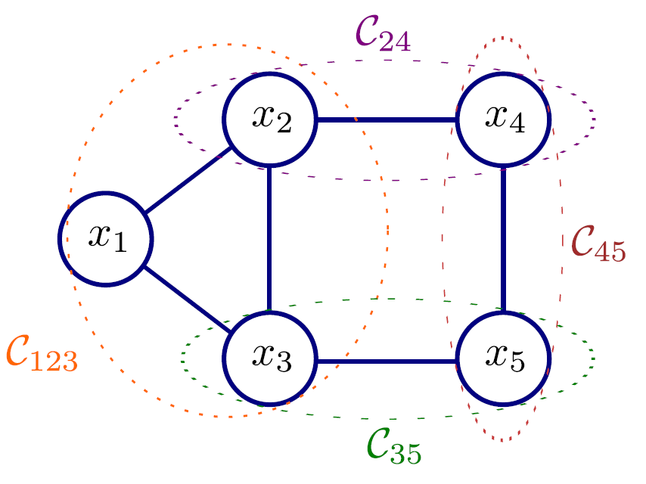
Example 2
Variables x₁ and x₂ form a clique (both connected to each other)
But not a maximal clique, as we can add x₃ and it is connected to both

Slide 31
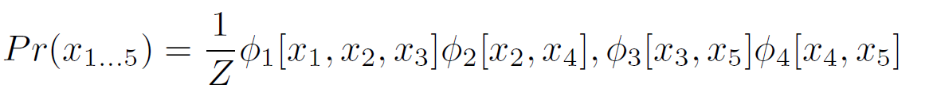
Example 2
Graphical model implies factorization:

Slide 32
Example 2
Or could be....
... but this is less general

Slide 33
Comparing directed and undirected models
Summary:
Some conditional independence patterns can be represented as both directed and undirected
Some can be represented only by directed
Some can be represented only by undirected
Some can be represented by neither

Slide 34
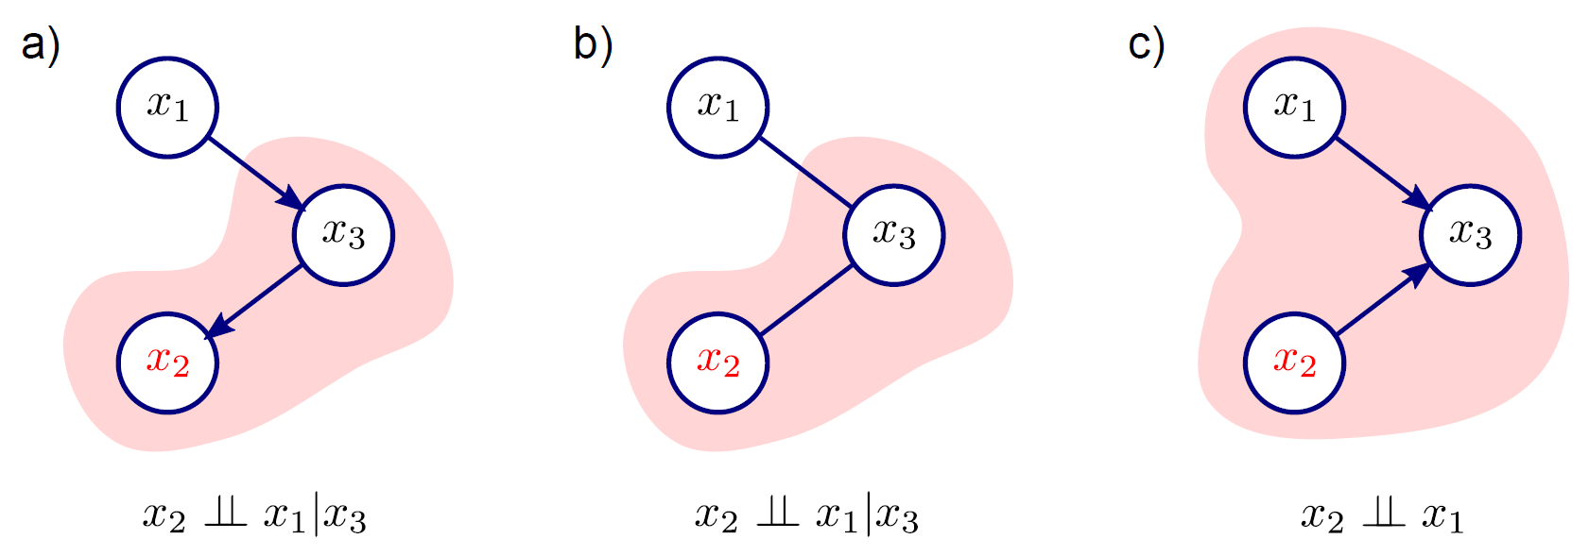

Comparing directed and undirected models
These models represent same independence /
conditional independence relations
There is no undirected model that can describe these relations

Slide 35
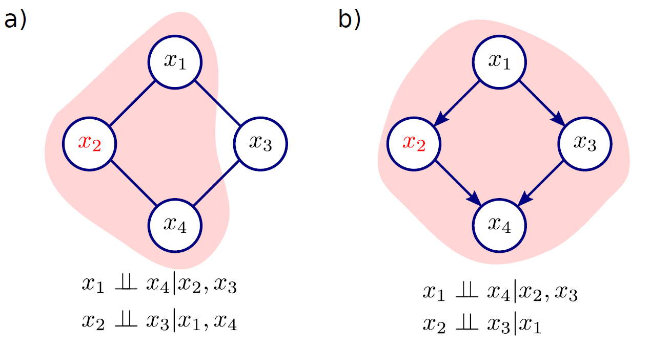
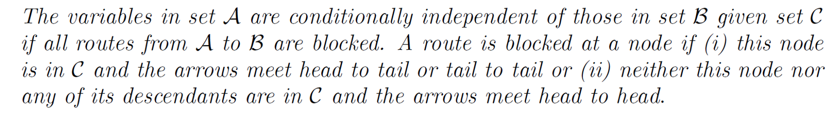


Comparing directed and undirected models
There is no directed model that can describe these relations
Closest example, but not the same

Slide 36
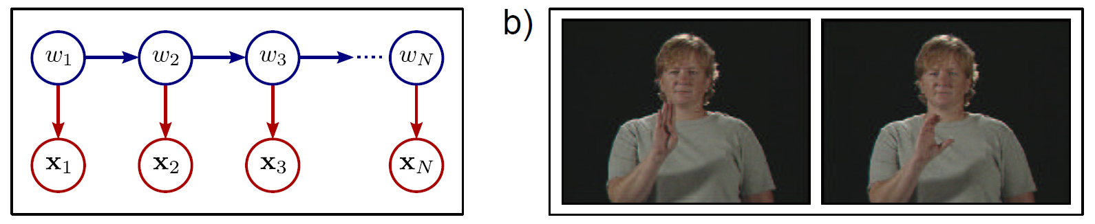
Graphical models in computer vision
Chain model
(hidden Markov model)
Interpreting sign
language sequences

Slide 37
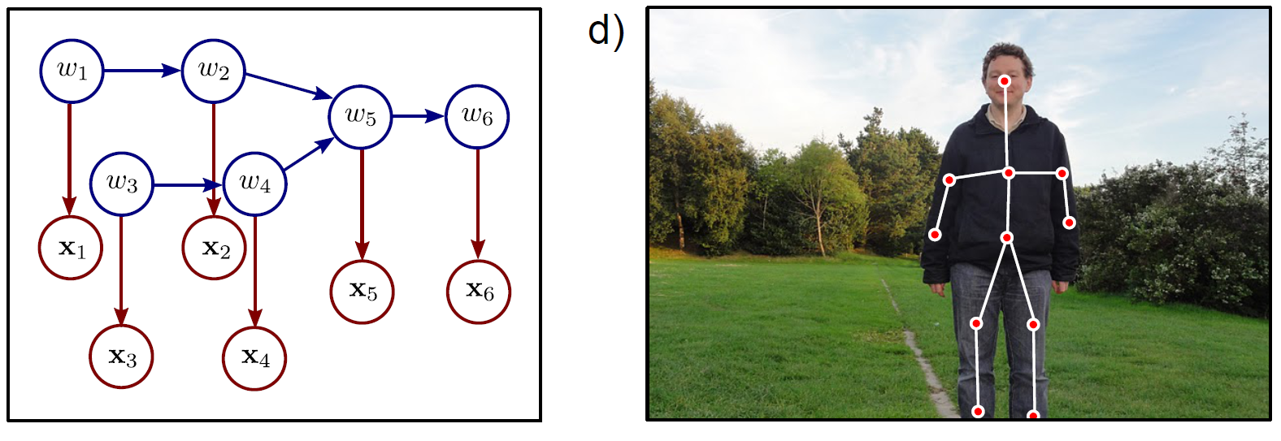

Graphical models in computer vision
Tree model
Parsing the human body
Note direction of links, indicating that we’re building a probability distribution over the data, i.e. generative models:

Slide 38
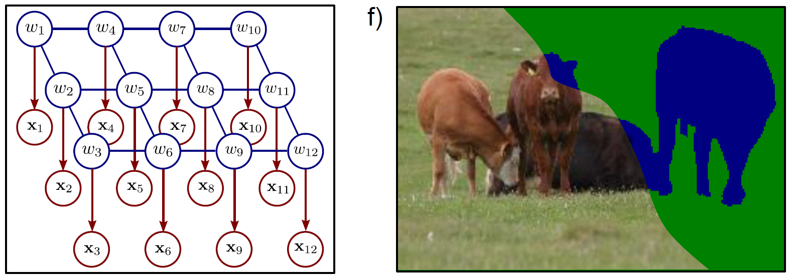
Graphical models in computer vision
Grid model
Markov random field
(blue nodes)
Semantic
segmentation

Slide 39
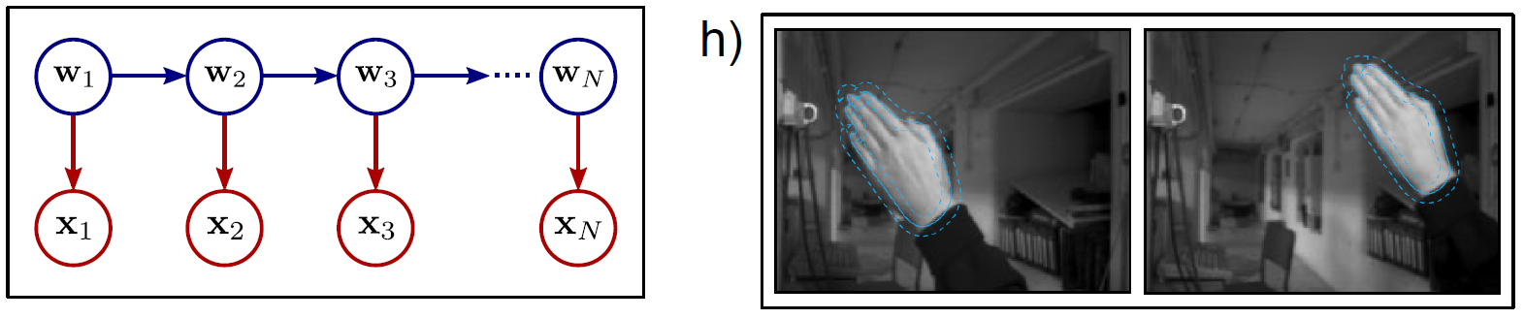
Graphical models in computer vision
Chain model
Kalman filter
Tracking contours

Slide 40
Inference in models with many unknowns
Ideally we would compute full posterior distribution Pr(w_{1...N}|x_{1...N}).
But for most models this is a very large discrete distribution – intractable to compute
Other solutions:
Find MAP solution
Find marginal posterior distributions
Maximum marginals
Sampling posterior

Slide 41
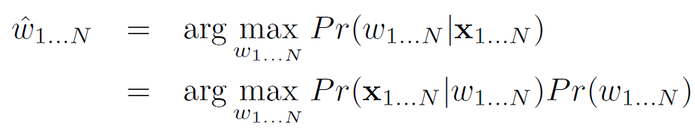
Finding MAP solution
Still difficult to compute – must search through very large number of states to find the best one.

Slide 42
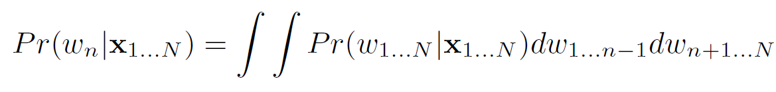
Marginal posterior distributions
Compute one distribution for each variable w_{n}.
Obviously cannot be computed by computing full distribution and explicitly marginalizing.
Must use algorithms that exploit conditional independence!

Slide 43
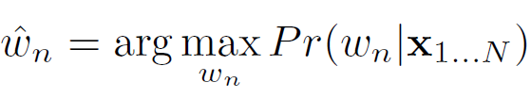

Maximum marginals
Maximum of marginal posterior distribution for each variable w_{n}.
May have probability zero; the states can be individually probable, but never co-occur.

Slide 44
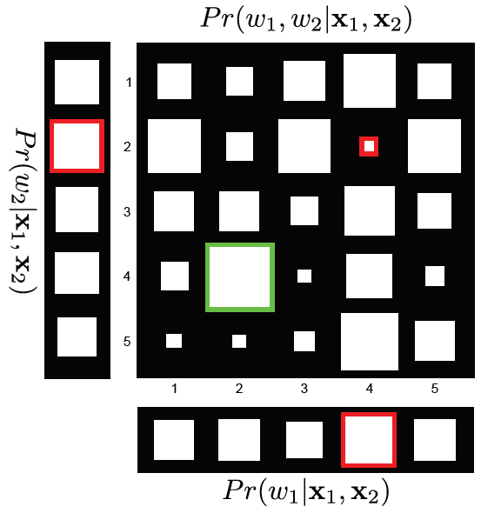
Maximum marginals

Slide 45
Sampling the posterior
Draw samples from posterior Pr(w_{1...N}|x_{1...N}).
use samples as representation of distribution
select sample with highest prob. as point sample
compute empirical max-marginals
Look at marginal statistics of samples

Slide 46
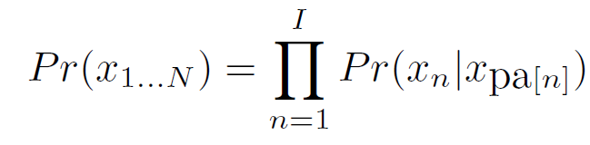
Drawing samples - directed
To sample from directed model, use ancestral sampling
work through graphical model, sampling one variable at a time.
Always sample parents before sampling variable
Condition on previously sampled values

Slide 47
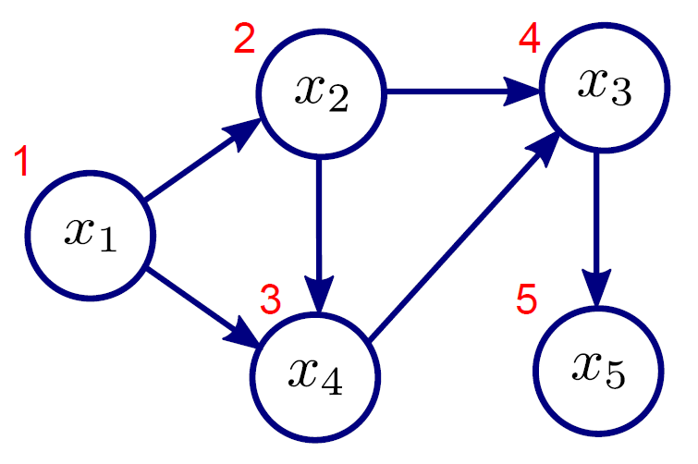
Ancestral sampling example

Slide 48

Ancestral sampling example
To generate one sample:
1. Sample x₁* from Pr(x₁)
2. Sample x₂* from Pr(x₂| x₁*)
3. Sample x₄* from Pr(x₄| x₁*, x₂*)
4. Sample x₃* from Pr(x₃| x₂*,x₄*)
5. Sample x₅* from Pr(x₅| x₃*)

Slide 49
Drawing samples - undirected
Can’t use ancestral sampling as no sense of parents / children and don’t have conditional probability distributions
Instead use Markov chain Monte Carlo method
Generate series of samples (chain)
Each depends on previous sample (Markov)
Generation stochastic (Monte Carlo)
Example MCMC method = Gibbs sampling

Slide 50
Gibbs sampling
To generate new sample x in the chain
Sample each dimension in any order
To update n^{th} dimension x_{n}
Fix other N-1 dimensions
Draw from conditional distribution Pr(x_{n}| x_{1...N\n})
Get samples by selecting from chain
Needs burn-in period
Choose samples spaced apart, so not correlated

Slide 51
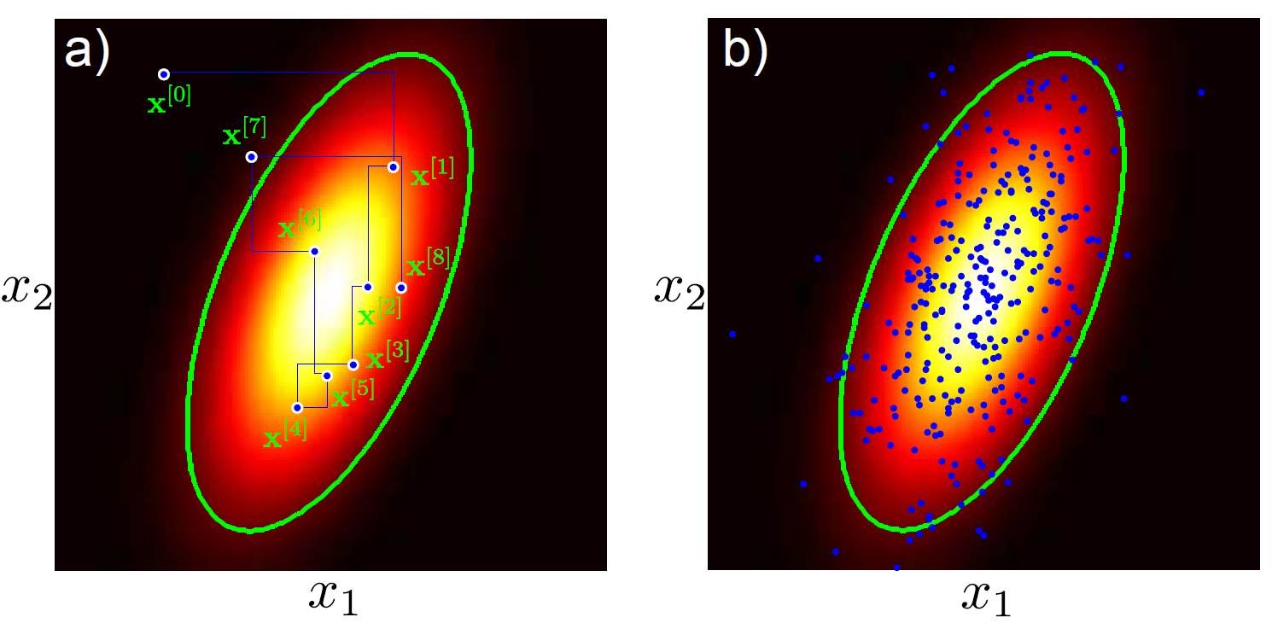


Gibbs sampling example: bi-variate normal distribution

Slide 52
Gibbs sampling example: bi-variate normal distribution

Slide 53
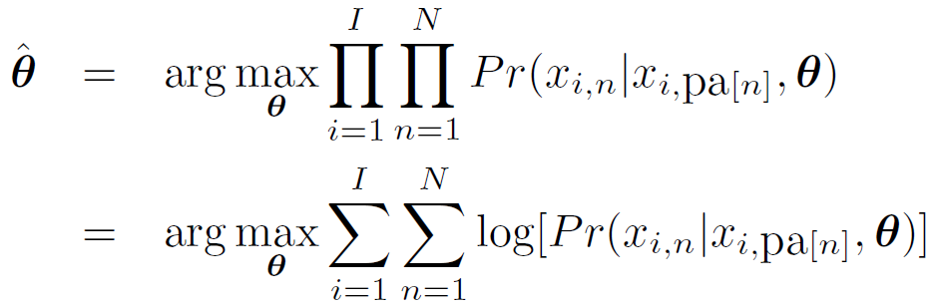
Learning in directed models
Use standard ML formulation
where x_{i,n} is the n^{th} dimension of the i^{th} training example.

Slide 54
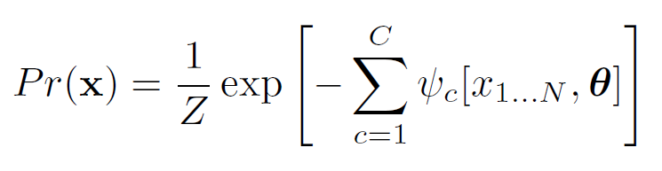
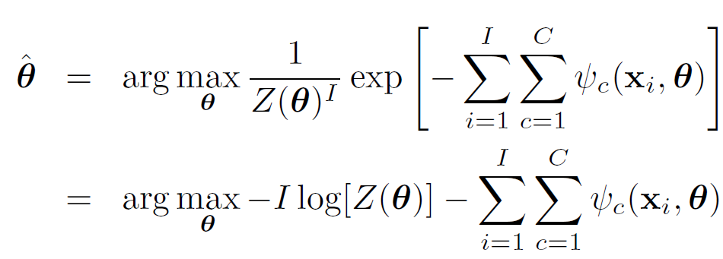
Learning in undirected models
Write in form of Gibbs distribution
Maximum likelihood formulation

Slide 55
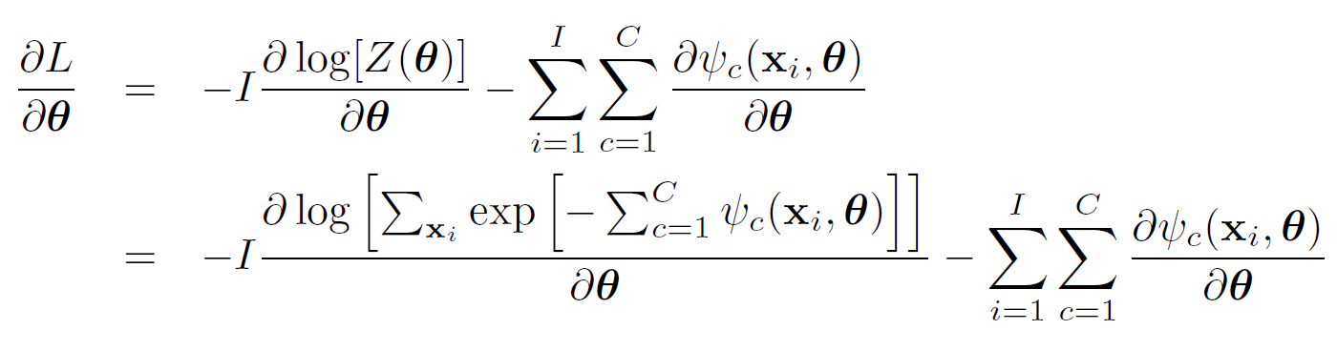
Learning in undirected models
PROBLEM: To compute first term, we must sum over all possible states. This is intractable

Slide 56
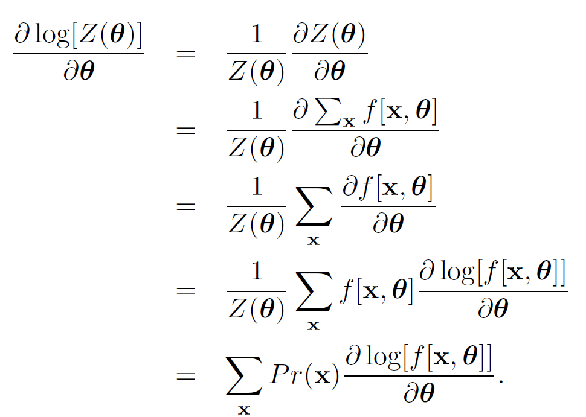
Contrastive divergence
Some algebraic manipulation

Slide 57
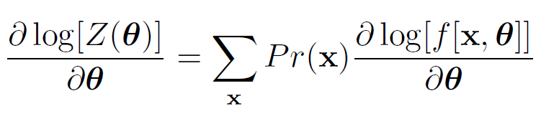
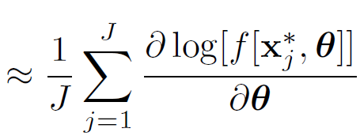
Contrastive divergence
Now approximate:
Where x_{j}* is one of J samples from the distribution.
Can be computed using Gibbs sampling. In practice, it is possible to run MCMC for just 1 iteration and still OK.

Slide 58
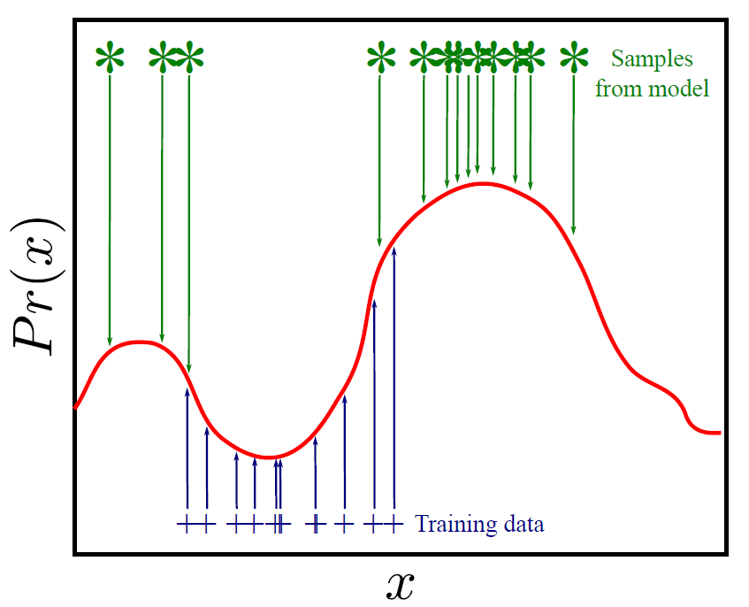
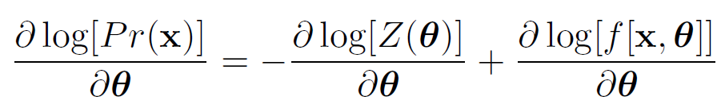
Contrastive divergence

Slide 59
Conclusions
Can characterize joint distributions as
Graphical models
Sets of conditional independence relations
Factorizations
Two types of graphical model, represent different but overlapping subsets of possible conditional independence relations
Directed (learning easy, sampling easy)
Undirected (learning hard, sampling hard)

